Slide 1
Hotel Cleaning Application Krishal, Sanjit and Cara

Slide 2
Aim To create order and reduce loss of time for Housekeepers and Management within the Accommodation Industry. Objectives 1] Research current methods used within the Accommodation Industry in respect to room maintenance. 2] Design, create and test an Android Application. 3] Design, create and test a Windows Application. 4] Design and create a database.

Slide 3
SCOPE - To create an Android and Windows application for Housekeepers, Management and Front Desk staff within the Accommodation Industry to use in order to lessen time used to report room statuses. Project Description - The issues faced in small to medium Accommodation Industries are ensuring the Front Desk is aware of the rooms completed with cleaning and ensuring customers do not enter un-cleaned rooms. We have taken this opportunity to create an Android Application for housekeeping employees to be able to report back to the Reception about which rooms have been cleaned in a matter of minutes of the task being done, and a Windows Application that will allow the Front Desk to assign housekeeping to specific rooms that require cleaning without having to find the housekeeper to assign them.

Slide 4
MOVs - 1] OPERATIONAL IMPACT – Our applications will make communication faster for the Housekeepers and Front Desk staff as it will allow communication in both directions to be done in real-time, without them having to travel to find the person(s) they wish to report to. 2] CUSTOMER IMPACT – This will be more impacting to the company as the Accommodation Industry is based on Customer Service so if the guest has requested an early check in the Front Desk will have Real-Time progress of each of the rooms completed and hence will adhere to the guests request therefore creating a rapport with the guest and ensuring quality service and therefore fulfilling the Business Objective. 3] FINANCIAL IMPACT – This is more impactful to the business as these applications will reduce time lost in Housekeepers coming to Front Desk to update on the rooms that they have completed and therefore these applications will eliminate this loss of time and hence will stop money being lost in the process.

Slide 5
Added Value(S)
Currently the system used in small to medium accommodation suppliers are that of each housekeeper is to report on rooms completed within 3 hours.
We will be changing this by:
Removing this manual reporting system to an interfaced reporting system.
Reducing loss of time
Ensuring communication is flowing between the housekeepers and front desk. Eg. If the room is needing something to be fixed etc.
Easier allocation of rooms to be cleaned or serviced

Slide 6
Area(s) Of Impact
The impact of this application will mainly be on:
Customer Service
Financial
Co-ordination
This application can increase this customer satisfaction by at least 10- 15% and if you were talking about Financial gain it would reduce at least 10mins of each staff member in a day therefore 30minutes if we had 3 staff members working and therefore 3hours and 30minutes wasted in the manual way of reporting hence paying for loss time.
Co-ordination is also very important as this will better ensure that all staff are communicating and therefore reduces the stress level of the staff and ensure quality work.

Slide 7
FUNCTIONALITIES 1] Android and Windows Applications to be simple to navigate with minimalized distractions. 2] An ‘update room’ function that is reliable in updating a room’s status. 3] An ‘assign’ function for Front Desk to assign cleaners to a room that requires attention. PLATFORM(s) USED Microsoft Windows – Visual Studio (Java) Android - Visual Studio (Java)

Slide 8
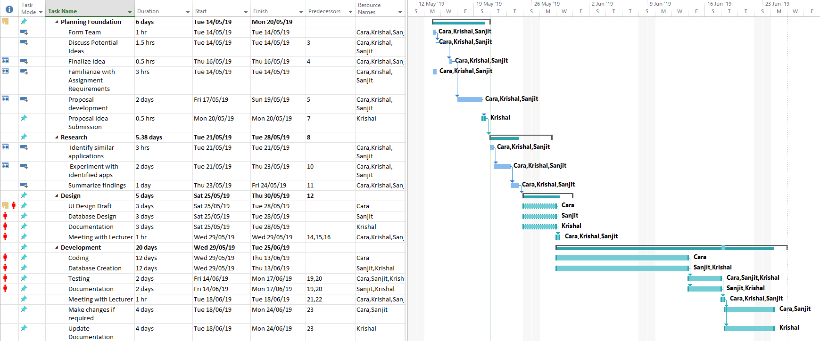
GANTT CHART

Slide 9
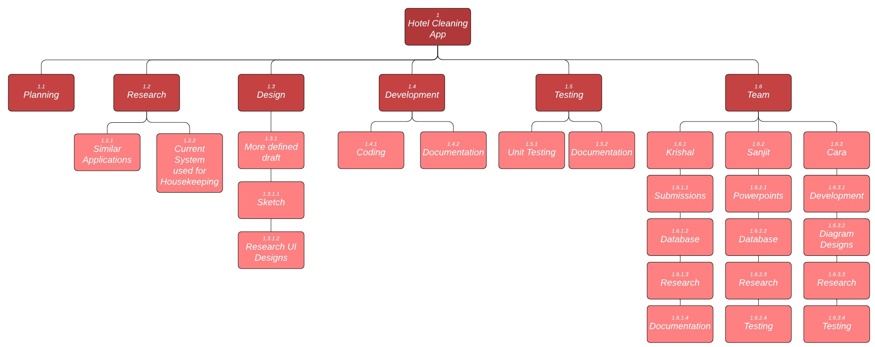
Cara: Development Use Case/Flow Diagram Sanjit: PowerPoints Database Krishal: Submissions Database Documentation Shared: Team Meetings Literary Review/Research Design Testing
WHO WILL DO WHAT

Slide 10
Risks and mitigation
Lack of Experience and/or Skill
Only one developer without much work experience.
Mitigation: Discussion with more experienced developers.
Utilizing online resources as much as possible.
Miscommunication
Easy to miscommunicate between different majoring students.
Mitigation: Continual meetings to ensure everyone’s on the same page.
Technology Failure
Computers/DB may give-in.
MITIGATION: Back up work at each phase.
Time
Limited time given to develop applications.
MITIGATION: Fairly distribute workload and team to follow deadlines (with some flexibility).

Slide 11

Thank you

